Slide 1

The Best Quarterback in the 2020 NFL Season
BUS 632 - Team C
December 13, 2021
Sydney Scaccia
Alexander Wortham
Bryan Telford
Emil Gomez

Slide 2

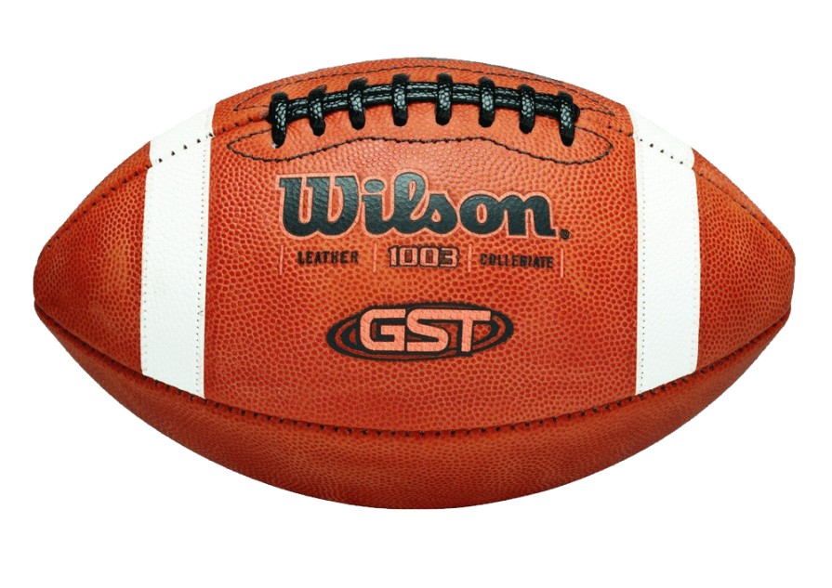
Data Variables
Independent Variables
Dependent Variable
Completion %
TD %
Passer Rating
Yards Per Attempt
Notes:
Completion % is defined by subtracting 30 from the percentage of passes that are thrown for completions, then multiply by .05.

Slide 3
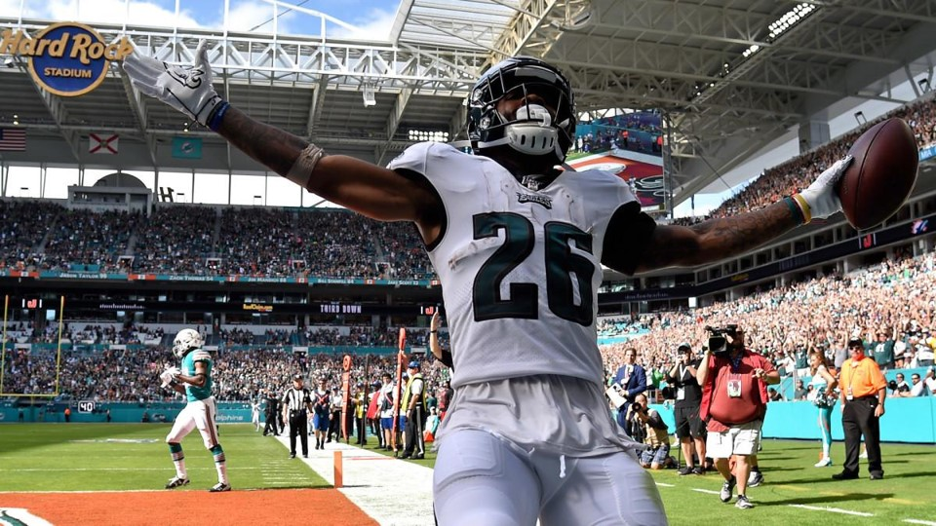

Regression Analysis
TD %
R-squared: 0.77356
Coefficient: 6.48605
P-value: 3.43E-11
Yards Per Attempt
R-squared: 0.72408
Coefficient: 14.44684
P-value: 6.86E-10
Completion %
R-squared: 0.65684
Coefficient: 2.73858
P-value: 1.89E-08
Notes:
Completion % is defined

Slide 4

Regression Results
The model with the highest R squared will be used throughout the rest of the analysis.
This variable with the highest R squared is Touchdown Percentage.

Slide 5
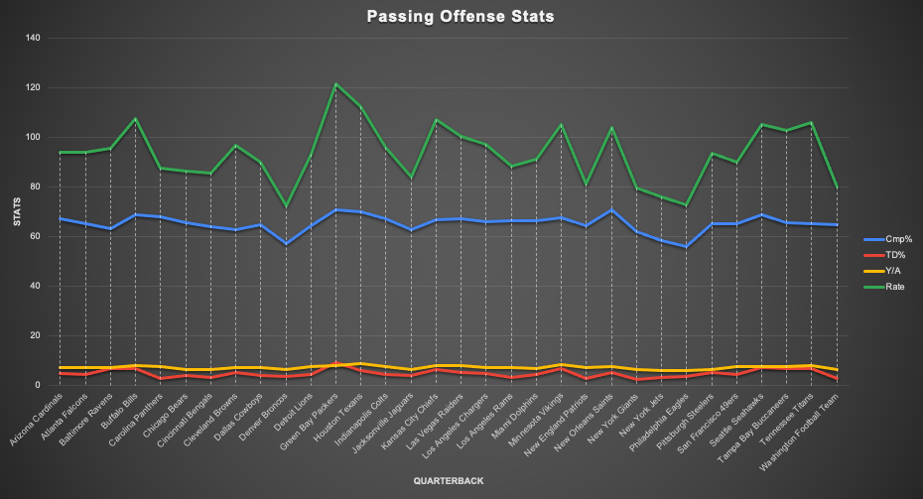

Slide 6
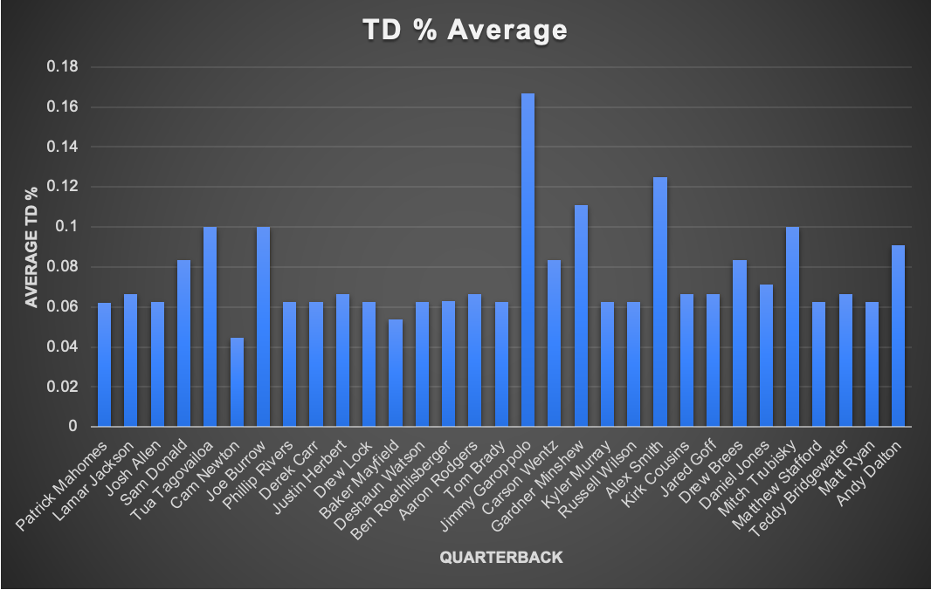

Slide 7
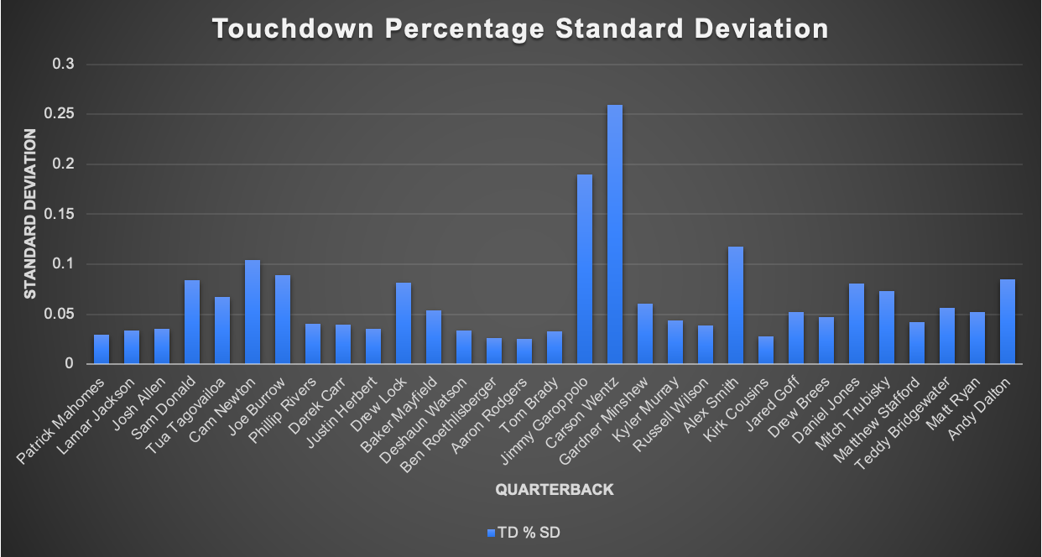

Slide 8

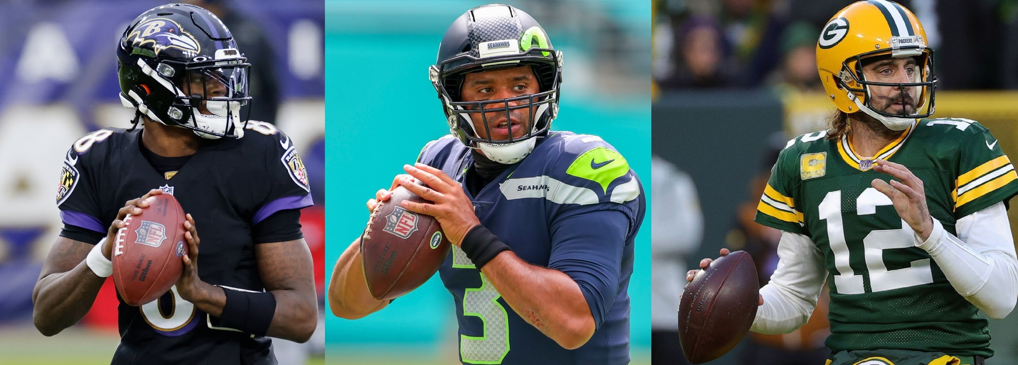
The Top 3 Quarterbacks
Lamar Jackson
Russell Wilson
Aaron Rodgers

Slide 9

T Test Results
Russell Wilson vs. Lamar Jackson
P-value: 0.376
Aaron Rodgers vs. Russell Wilson
P-value: 0.353221
Aaron Rodgers vs. Lamar Jackson
P-value: 0.5
The results are not statistically significant.

Slide 10
F Test Results
Russell Wilson vs. Lamar Jackson
P-value: 0.315287
Aaron Rodgers vs. Russell Wilson
P-value: 0.007436
Aaron Rodgers vs. Lamar Jackson
P-value: 0.024123
Aaron Rodgers is the most consistent

Slide 11
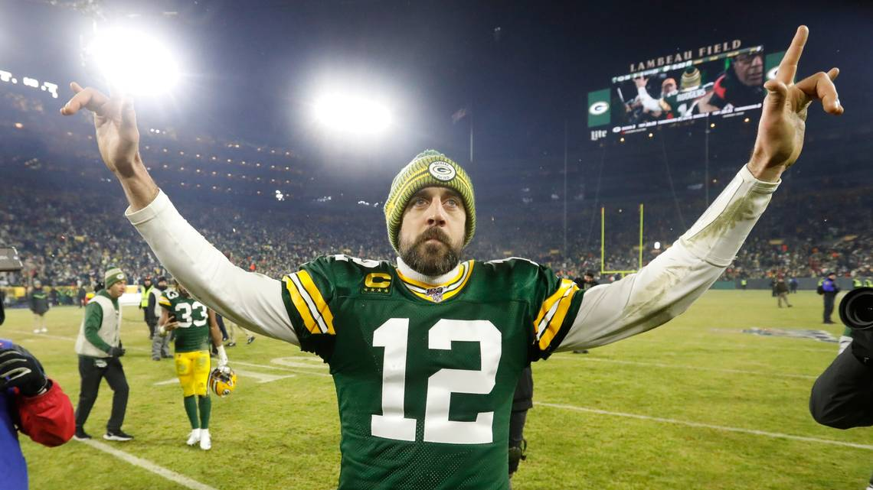
Aaron Rodgers
Best Quarterback in 2020

